Slide 1
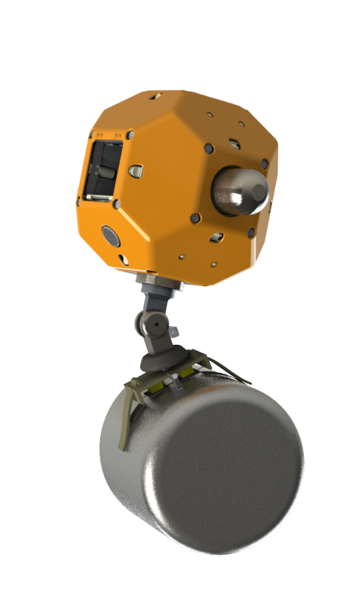
Control of an Active Wrist for a Gecko-Inspired Adhesive Gripper
Negin Heravi, Matt Estrada
Stanford University
September 26, 2017

Slide 2
Project Goal
Use active control to take into account our model on adhesion limitations.
2

Slide 3
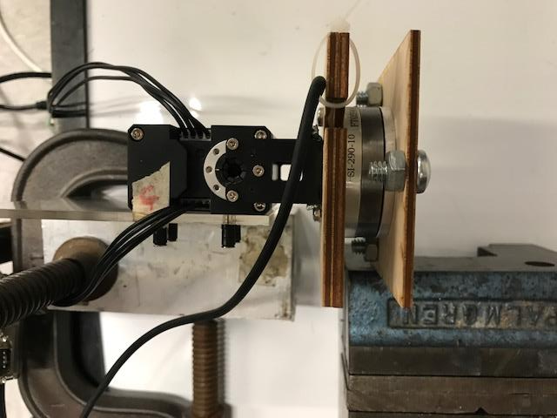
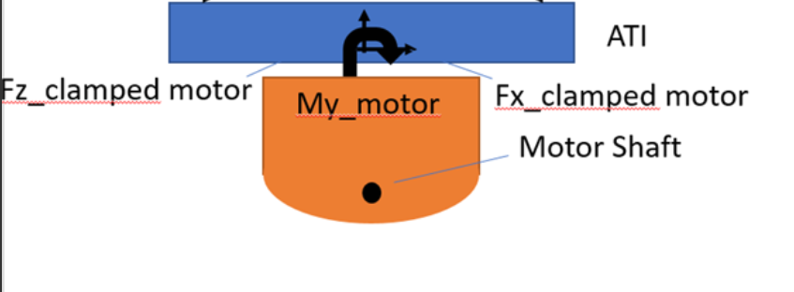
Dynamixel Current control – Set up
System is Grounded
* Dynamixel is what In Won is using so it will port to Astrobee well.
* Both the ATI and the motor are being controller in Visual C++
running on Windows
3

Slide 4
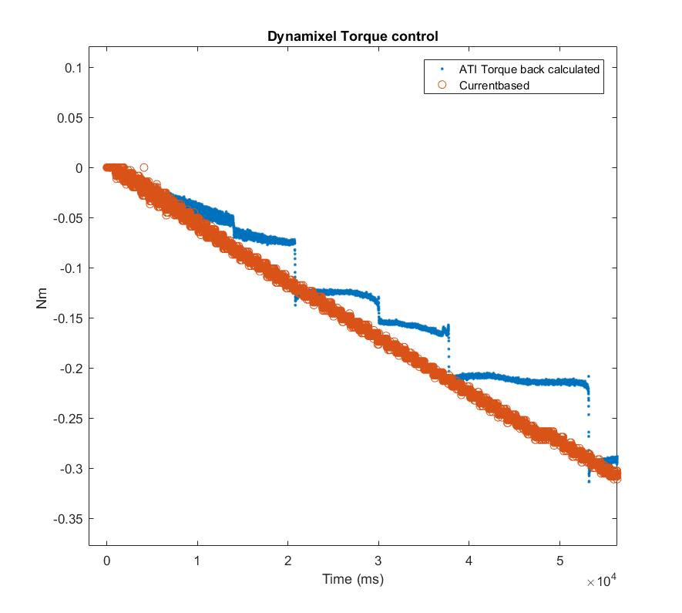
Dynamixel Current control
* There seems to be unexplained jumps in ATI data
4

Slide 5
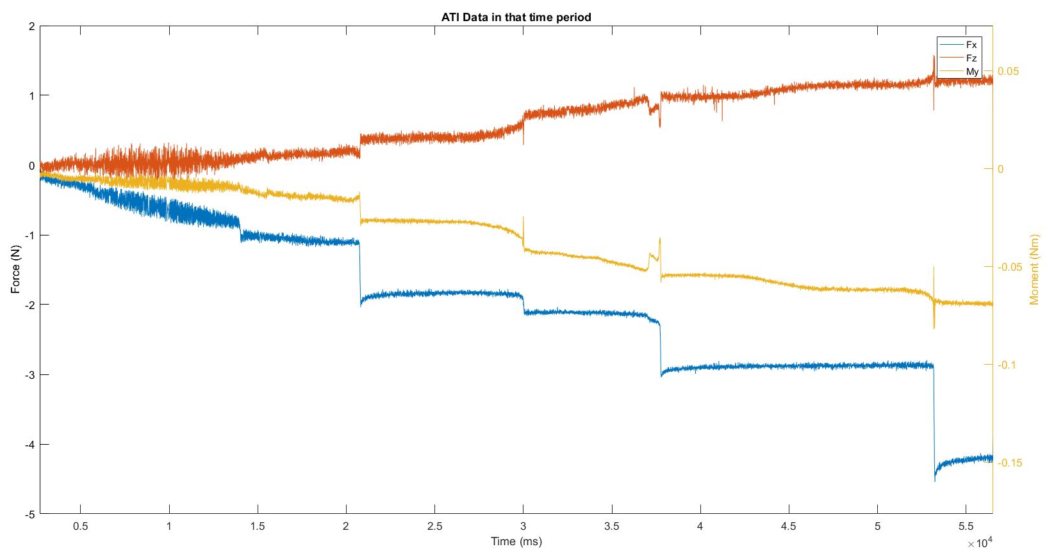
Dynamixel Current control
F_{x}
M_{y}
F_{z}
* Despite the continuous commanded torque, sensor data seem chunked.
5

Slide 6
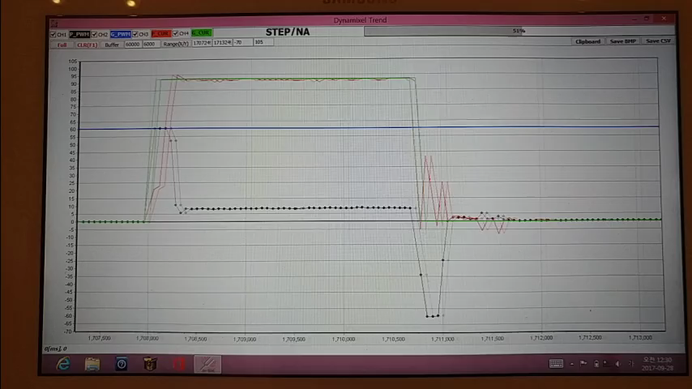
Company’s Current Control
6

Slide 7
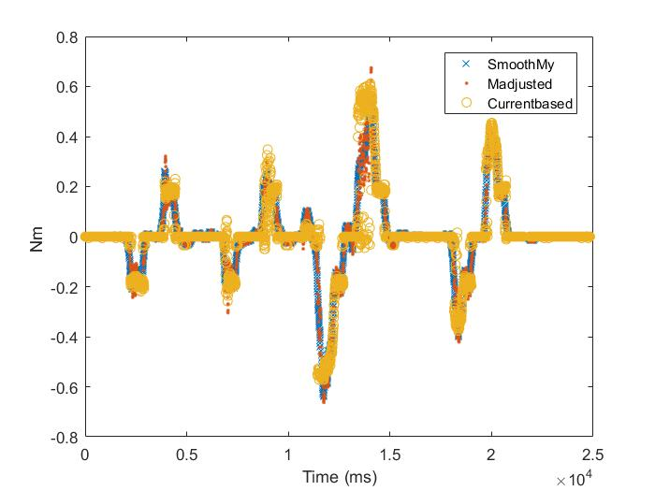
Commanding Torque at Adhesion Limits
Object was moved around by hand
7

Slide 8
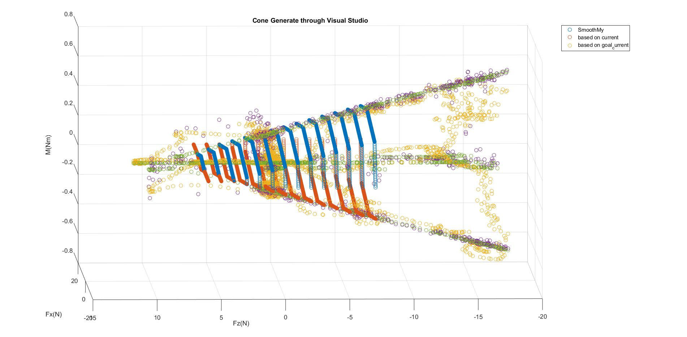
Commanding Torque at Adhesion Limits
Object was moved around by hand
8

Slide 9
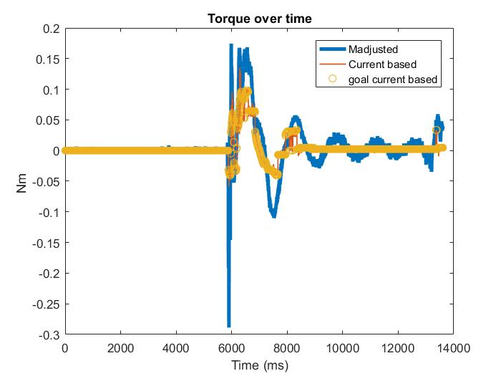
Impedance control with only Spring/Damper Term
9
Current based = Current Register of the motor
Goal Current based= Commanded Desired Current

Slide 10
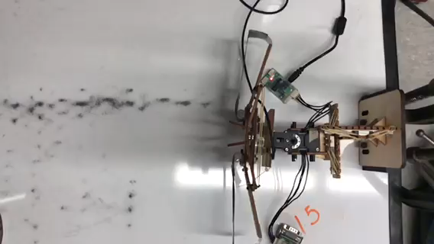
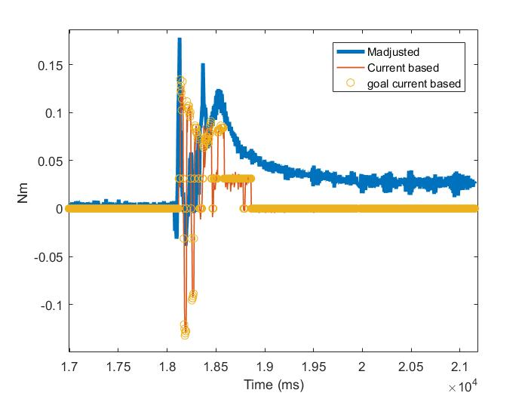
Torque Data Match in Catching
Bi-stable Collapse
Controller Off
10
Notes:
Trial 15

Slide 11
Torque Data Match in Catching
11
Notes:
Trial 15

Slide 12
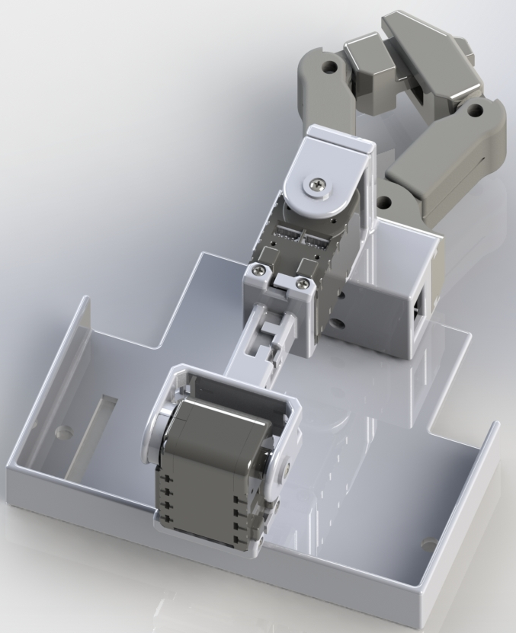
Proposal For Fall Quarter
(1) Work with In Won to add modules to his
arm with compliance+ Gecko
(2) Work with Jose, Genliang, Matt to improve upon
the current passive design
12

Slide 13
Path moving forward for torque control
If we still want someone to keep working on this:
Motor Control
Sensor
DZEANTU-020B080
Opto-Force 3D
brushed and brushless servomotors
Limitation 20 N in Fx readings
$665
Cheaper than ATI but don’t know the exact price
EtherCat
digital servo drive
EtherCat
Mode/gains change on fly
Operating modes - profiled position, velocity, current, cyclic synchronous position, velocity, current, or customized mode
ATI Mini
limitations……
$3,985.00
EPOS2 24/2
$494
DC/EC Motors
Interfaces: MS Visual C#,C++,basic,basic.NET,LabView
Operating mode: Current, Speed, Position
Currently have it running in Visual Studio C++
Tree Robotics
13

Slide 14
Extra
14

Slide 15
EOM
To be added
15

Slide 16
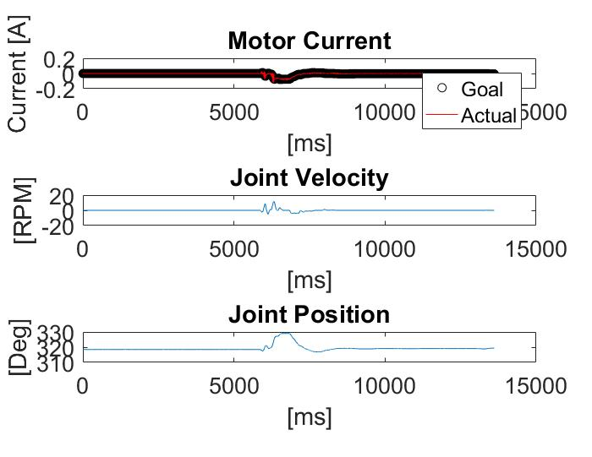
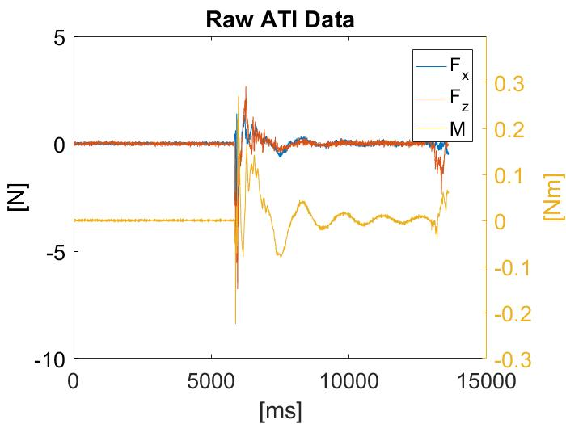
PD control- Extra slide
16

Slide 17
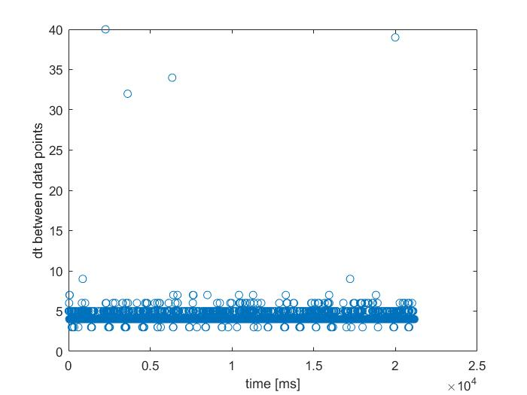
Extra slide
17

Slide 18
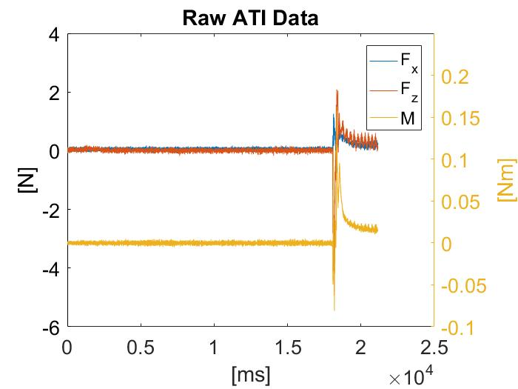
Extra slides
18

Slide 19
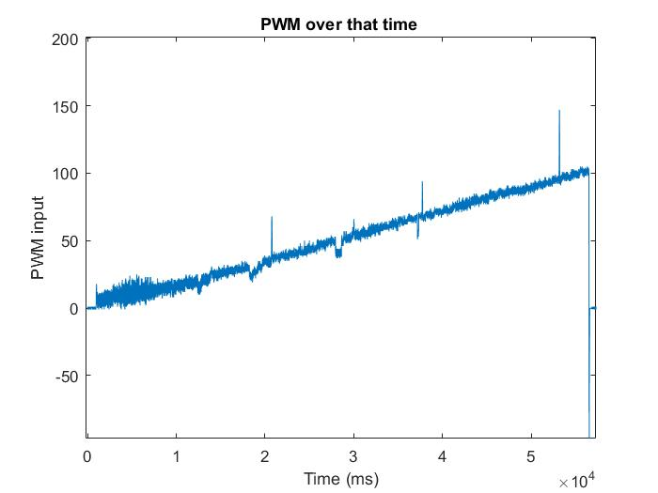
Dynamixel Current control
* The jumps seem to be correlated to jumps in PWM data.
19

Slide 20
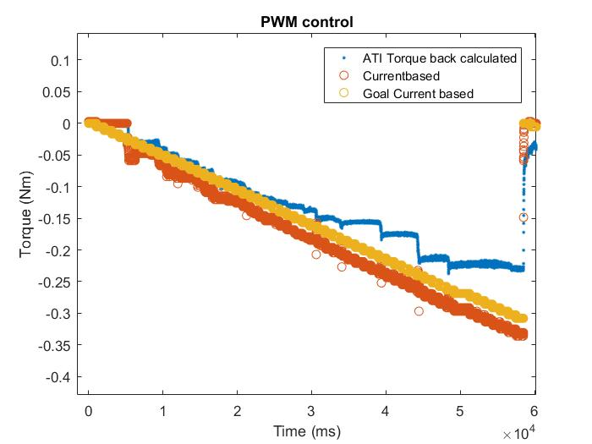
PWM control
* To assess the source of the problem the motor was run in PWM control and a similar problem
was observed ….. //Fix this no goal current ….
20

Slide 21
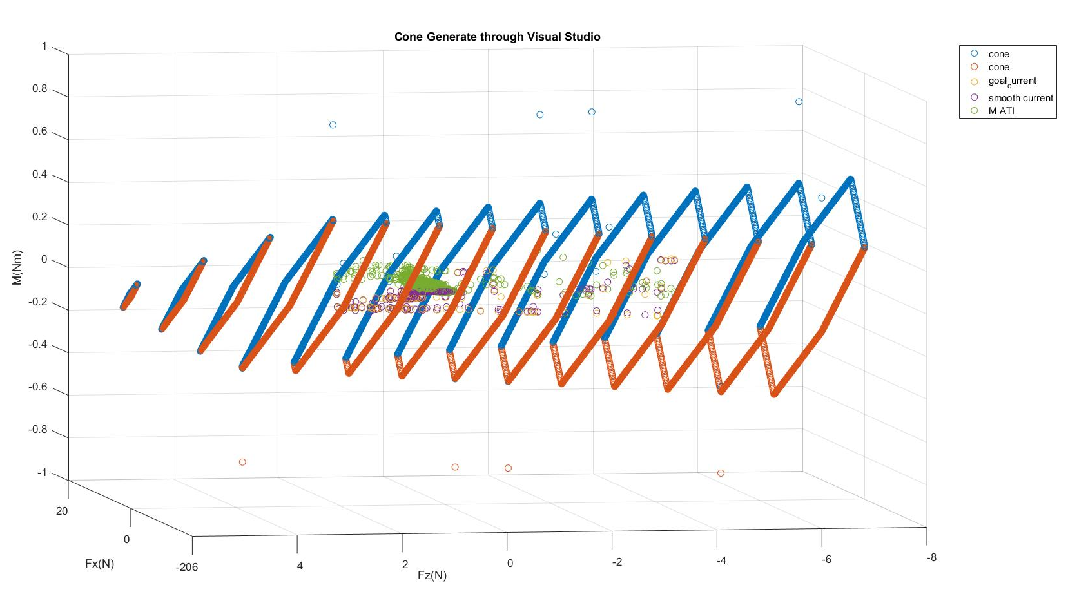
Real Catch Scenario
80 % seems like a reasonable safety factor (this is very hand-wavy) more extensive study should be done
to have a definite number.
21

Slide 22
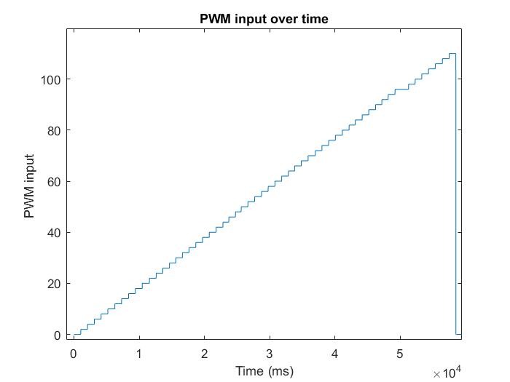
Dynamixel Current control
* Currently talking with the company to find the source of the problem
* Maybe the motor is somehow getting stuck?
22

